Slide 1
BRITISH AIRWAYS
WEB SCRAPING TO GAIN COMPANY INSIGHTS

Slide 2
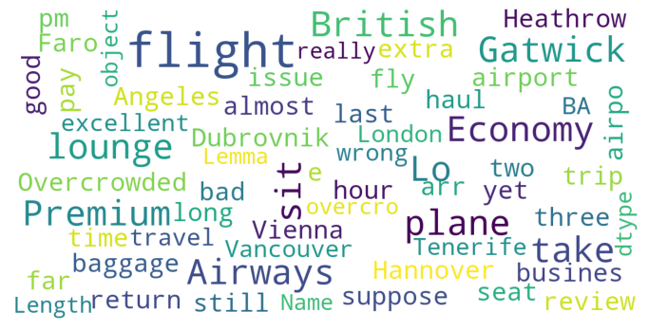
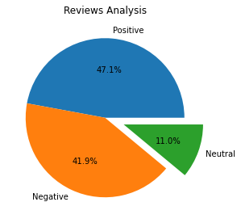
INSIGHTS FROM CUSTOMER REVIEWS
After Cleaning 1000 reviews given by the customers, we Obtained:
Positive 471
Negative 419
Neutral 110
Word Cloud of keywords obtained in reviews:

